Slide 1
How are élites and citizens congruent? Representing 'the people'
Luca Verzichelli
Pactum Summer School – University of Kairouan
9 October 2021

Slide 2
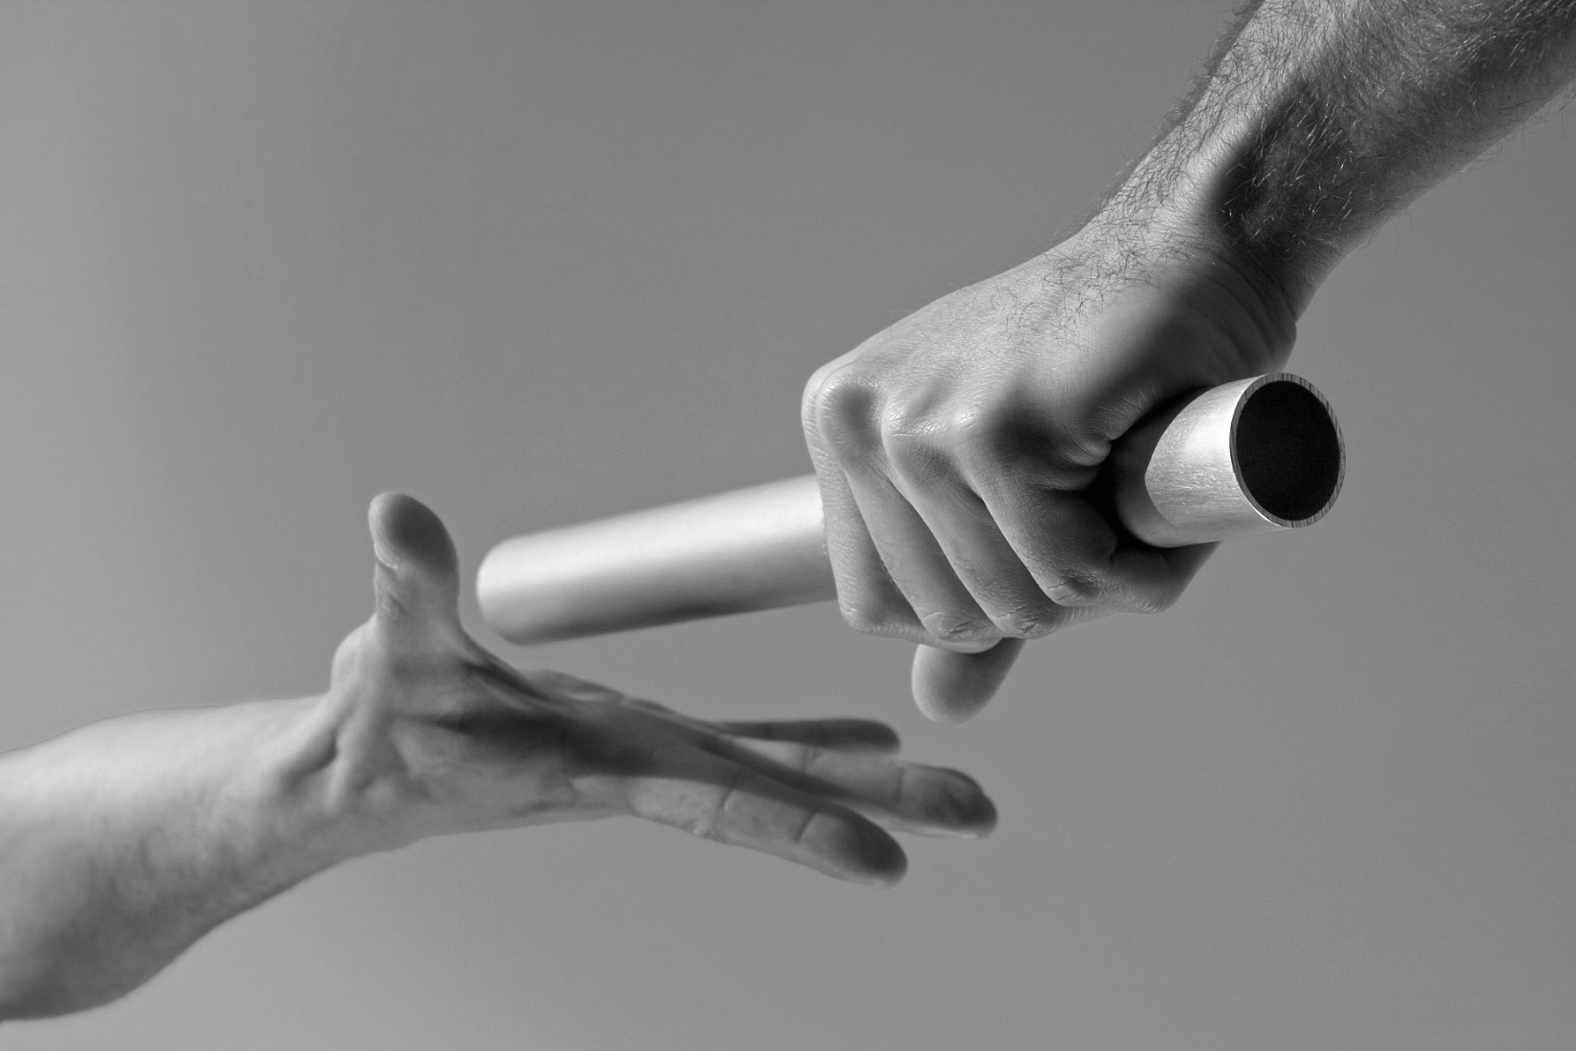
A few questions?
Qu'est-ce que c'est
a «representative body»?
Organe représentatif
a «representative élite»?
élite représentatif
A «representative delegation»?
mandat représentatif

Slide 3
Historical antecedents of modern representation Historique Antécédent de la Modern Representation
The Roman tradition: «elders» and «wise men»
Reducing the community’s complexity: the «States general»
Montesquieu: the modern idea of a «legislative body»
Burke: delegate or trustee?
La tradition de la Rome antique: «Ainés» et «Sages»
Asemblée de l'Ancien Régime: nobles, clergé et tiers état.
Montesquieu: Esprit des Lois
Burke: «Deléguer» out «Fiduciaire»

Slide 4
Marriage between Representation and Democracy Mariage entre representation et démocracie
Élite democracy:
Representation as a distinction between rulers and ruled
Procedural democracy
Representation as a guarantee of respecting popular will
Party democracy
Representation as professional élitism
Audience democracy
Representation as a «mood» perceived by media
Élite democratie
Democratie et procédure
Démocratie et partis politiques
Democratie du public

Slide 5
Modern Representation Représentation et démocratie contemporaine
Compound relationship between represented and representatives
What is at stake: responsiveness or responsibility
Different models of representative democracy (i.e. parliamentary democracy vs. Presidentialism)
Normative criteria to evaluate representation
Political context

Slide 6
Pitkin: representation
Formalistic
Descriptive
Symbolic

Slide 7
Representative Roles
Delegate
Trustee
Politico

Slide 8
Crisis of representative Democracy
Mistrust towards «politicians»
Weak impact of legislative elites vis-a-vis executive politics
The congruence gap

Slide 9
